Slide 1
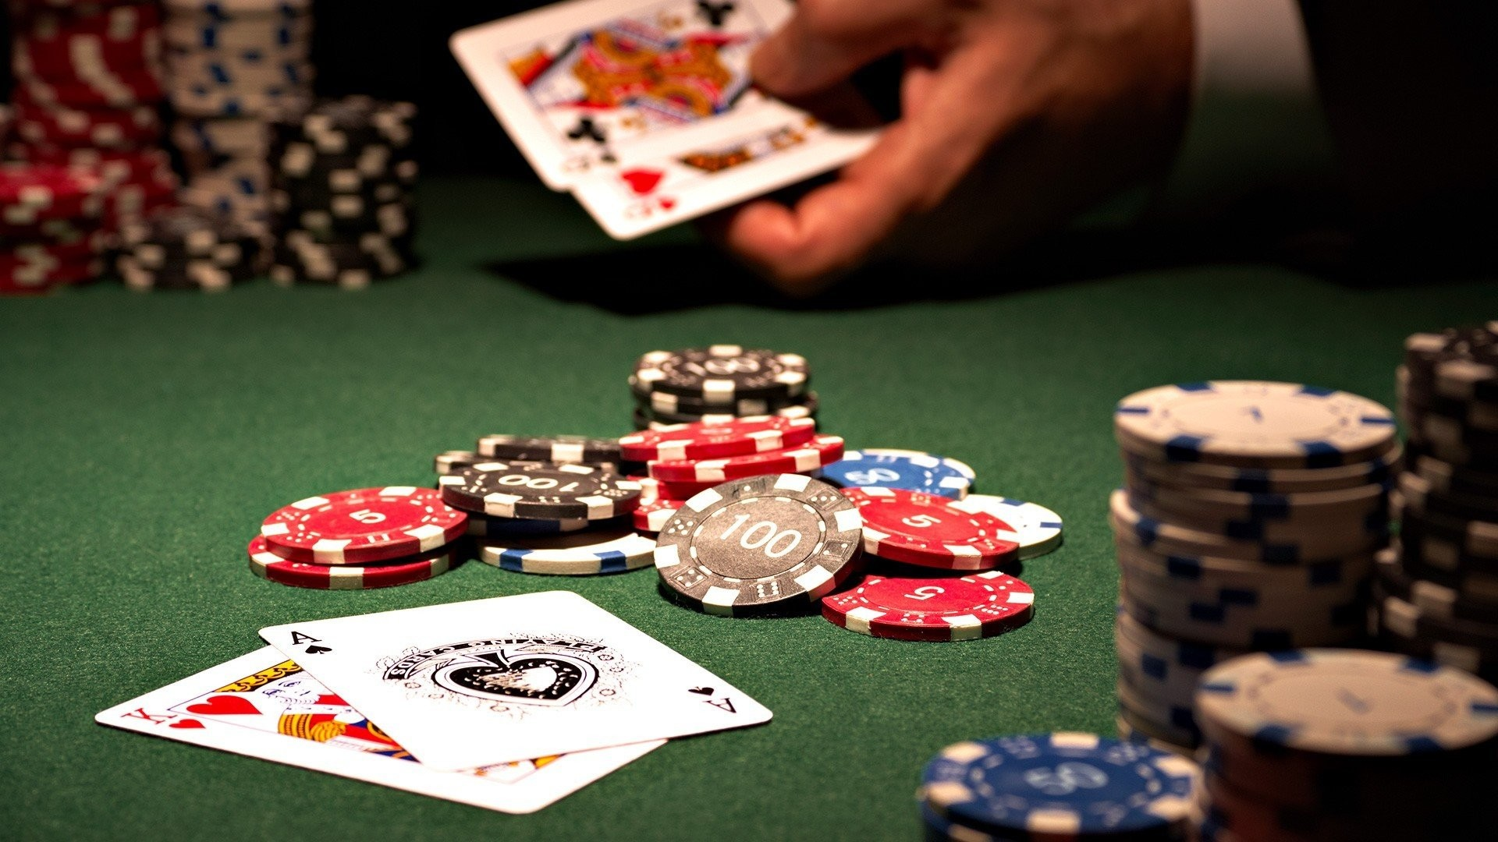
Term Project Game:
Texas Hold’em
Group members:
Justin Su
Arpaiana Tursunalieva
Victor Uong
Kayla Young

Slide 2

Authentication
Texas Hold’em
Log In
Username
Password
Create Account

Slide 3


















Account Creation
Create Account
Username
Password
Select Avatar
A
B
C
D
E
F
G
H
I
J
K
L
M
N
O
P
Q
R
S
T

Slide 4
Waiting Lobby
Texas Hold’em
Create Game
Return to game
Rules
Log out
Game Title
Players
Status
List of Players
Participant1’s game
2 / 6
Waiting
participant1
Participant6’s game
6 / 6
Full
participant2
participant3
participant4
participant5
participant6
[participant1] Hello, who wants to play a game?
Enter

Slide 5
Lobby Features
Every account ID logged in will appear on the right side in “list of participants”
The chat feature at the bottom can be seen by all participants
Upon creation of a game, the host can specify special rules of the game such as betting limits/starting amounts/small and big blind increments
A game can start as long as there are 2 players to a maximum of 6 players
If the user has left an ongoing game, he can re-join at anytime, provided the game hasn’t finished. The user will return but must wait if the round is still ongoing. Once the round is finish, the user will be given 2 cards and the game will proceed as is

Slide 6
Rules Page
HOW TO PLAY
Back to Lobby
Log out
Basic Rules
- turn orders
Betting
- need to read the rules
Cards Rankings
High card < Pair < Two Pair < Three of a Kind < Straight < Flush < Full house < Four of a kind < Straight flush < Royal flush

Slide 7
Game Board
Menu
Player5: 100$
Player4: 100$
Rules
Log out
Dealer
Small blind: 2$
Big blind: 4$
Deck
8 ♠
3🔶
5 ♠
K🧡
6🧡
Player6: 75$
Player3: 100$
Pot: 100$
chat
Q ♠
3🧡
Player1: 175$

Slide 8
Game Features
Each player starts with 2 cards in their hands.
The order of the game is clockwise
There are 4 phases of the game: preflop (before any cards shown), flop (first 3 card), turn (4th card), river (5th card)
Every player starts with a fix amount of chip (representing money)
For each hand, 2 players on the table are obligated to post a small or big blind (fixed amount of money to prevent game from plateauing). The blinds increases after a set amount of rounds. Generally, the small blind is half of the big blind.
A “dealer button” is placed on the table, which determines the position of the small/big blind, as well the last player to act. At the start of a game, this position is determined randomly?
The small blind is the next clockwise player to the dealer button, and the big blind is clockwise from the small blind
Each player has 4 actions: call, raise, check, or fold.
Call: match the amount from previous player
Raise: increase the bet amount
Bet: first player who makes the bet
Check: passes an action to the next player without betting
Fold: throw away the hand
If the dealer button raises, it goes through the loop again, until the betting is “closed”, e.g reaches the dealer button again and no raises has been made.
After every round, all cards are returned to the deck and shuffled again.

Slide 9
Game Features
Game Mechanics:
Ability to select 4 actions: call, raise, check or fold
Ability to raise as many chips as the player has in his stack
If the user raises all of his chips, then it is called “all-in”
In a “all-in” case for the user, cannot perform any action until the end of the round.
The pot contains all money placed in bets, and will be given to the winner of the round.
5 cards from the deck are placed face-up on the table in different stages (flop, turn, river)
Gameplay:
Objective is to be the last player standing (the player that keeps all the chip/money)
When a player no longer has any chip, he leaves the game (and his game ranking is shown)
Hand Scoring:
Implement a scoring system that calculates the strength of each player hand + community cards

Slide 10
Game Features
Game Settings:
Implement logic that allows player to customize their avatars and in game names
Implement feature that lets player customize their cards and change background pic
User should be able to create and login to the account
Save:
Implement a feature that saves the current status of the game after each player inputs an action
Implement a feature that loads the current status of the game when a player leaves and re-joins
Implement a feature where if a user re-joins a game, must wait until the round is finished
Chat:
Player should be able to chat with other players during the game

Slide 11
Match End
Lobby
Log out
Match End
Winner!
Player2
Player3
Player4
Player5
Player6
Player1
Total chip:
$1,738

Slide 12
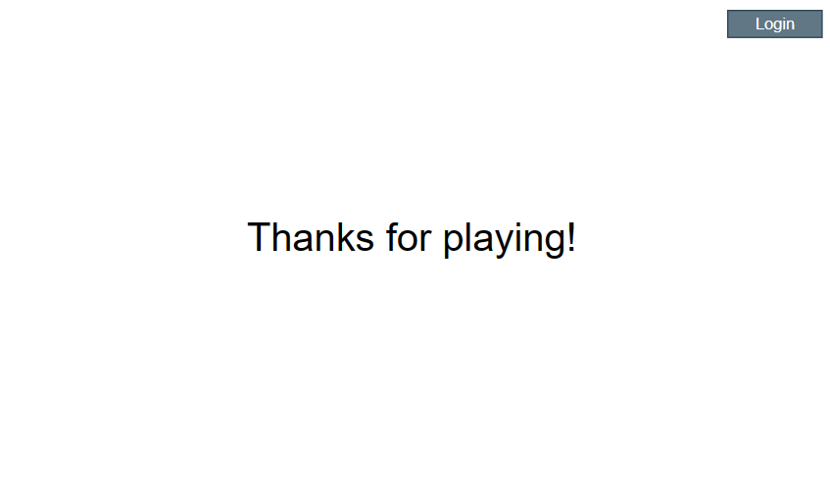
Logout/Thanks for playing

